Slide 1
HIBI Datasheet Presentation
Heterogeneous IP Block Interconnection
Tampere University of Techonology
Erno Salminen, November 2009
Update March 2010

Slide 2
Contents
Objectives
Basic HIBI Transactions
HIBI bus side signals, arbitration, commands, addressing, transfers
IP side signals, timing, wrapper types, VHDL notes
Configuration of HIBI
Using HIBI in Kactus

Slide 3
What is System-on-Chip on FPGA?
IP-block granularity for functional units
Application independent interface to allow re-use of processors and IP-blocks
Communication and computation separated
Communication network used in all transfers, no ad-hoc wires between IPs
CPU
CPU
IP-BLOCK
Wrapper
Wrapper
Wrapper
On-Chip network
Wrapper
Wrapper
Wrapper
MEMORY
IP-block
MEMORY

Slide 4
Special requirements on FPGAs
Interconnection networks for FPGAs must
keep the number of wires low
avoid global connections
avoid 3-state wires
support local clock domains for IP granularity

Slide 5
HIBI network example
HIBI Bus segment
HIBI Bus segment
IP BLOCK
IP BLOCK
IP BLOCK
IP BLOCK
HIBI
Wrapper
HIBI
Wrapper
HIBI
Wrapper
HIBI
Wrapper
Bridge
HIBI
Wrapper
HIBI
Wrapper
HIBI
Wrapper
HIBI
Wrapper
HIBI
Wrapper
HIBI
Wrapper
HIBI
Wrapper
HIBI
Wrapper
IP BLOCK
IP BLOCK
IP BLOCK
IP BLOCK
IP BLOCK
IP BLOCK
HIBI
Wrapper
HIBI
Wrapper
HIBI
Wrapper
Clock domains

Slide 6
HIBI network
HIBI network consists of wrappers, bus segments and bridges
HIBI wrapper is FIFO-based interface to network
HIBI wrapper is both master and slave (can initiate and respond to requests)
Arbitration is distributed to wrappers without any central controller
"Network" consists of bus segments
All signals in segment are shared between wrappers in network side, no dedicated point-to-point signals
Bridge includes 2 wrappers and connects two segments together
HIBI network
HIBI interface
HIBI
wrapper
HIBI
Wrapper
HIBI
Wrapper
HIBI
Wrapper
HIBI
Wrapper
HIBI
Wrapper
HIBI
Wrapper
FIFO interface
P₁
...
P_{N}
Mem₁
...
Mem_{N}
Acc₁
...
Acc_{N}
IP

Slide 7
HIBI Benefits
Comparison
AMBA AXI: 151 global signals
HIBI v2: 37 global signals (muxed addr/data)
HIBI v3: 69 global signals (parallel addr/data)

Slide 8
Basic HIBI Transactions

Slide 9
Basic HIBI Transactions
HIBI wrapper
HIBI wrapper
Write
Includes destination address
Data is sent in words (=HIBI bus width)
Several words can follow: all will be sent to the same destination address
Read
Read is implemented in two steps: read request + write to requester
Includes destination address and return address (where to put the data)
Data is received in words
Several words can be received (all to same return address)
No handshaking: data is transmitted/received when bus, sender, or receiver are available
No acknowledgements or flow control
HIBI command,
destination address,
[return address]
Tx FIFO
Rx FIFO
[Data]
HIBI command,
destination address,
[return address]
Rx FIFO
Tx FIFO
[Data]
Write
1.
2.
n.
Dst addr
Data
Data
Read
1.
2.
Dst addr
Return addr

Slide 10
HIBI Basic Transaction Motivation
HIBI was motivated by streaming applications where continuous flow of data is transmitted between IPs
Destinations are merely ports than random accessed memory locations
HIBI is not natively a processor memory bus but can be used for it as well
Single destination address can follow unlimited data words
No flow control is used when both IPs know how much and what kind of data is transmitted
This requires system design level specification
Flow control can be agreed at IP/system level or by further developing HIBI specification
HIBI takes care of re-transmission at link level

Slide 11
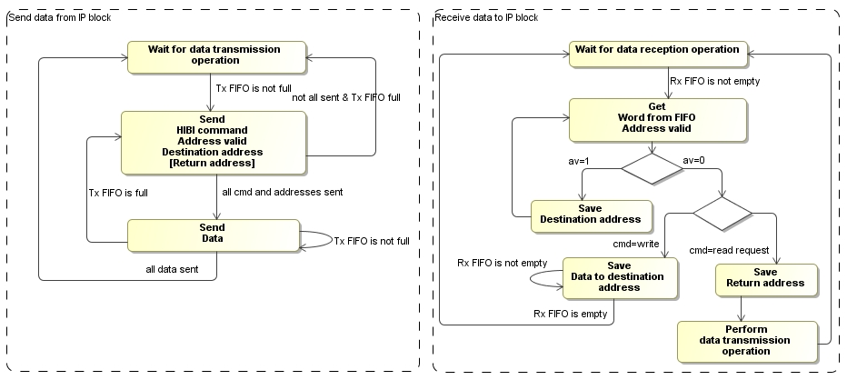
HIBI Basic Transaction Logics

Slide 12
HIBI Destinations
HIBI wrapper
IP-block
Address logic (e.g. increment)
Addr A
Rx/Tx FIFO
Addr 0
Addr 1
Addr N
Port A
Mem location 0
Mem location 1
Mem location N
Addr B
Port B
HIBI destination addresses are
internal registers
ports (to/from IPs internal logic)
IPs memory locations transparent to outside
Burst transfers use ports and IP block must perform addressing (increment) internally since all data is sent to one address
If IPs memory is transparent, the address seen outside includes also IP-block address (e.g. 0xB100, of which internal memory is 0x100)

Slide 13
HIBI Channels
IP block “IP1”
HIBI wrapper
HIBI wrapper
HIBI transfers can be abstracted as channels at IP-block side (but not formally specified how)
Easiest way to separate channels is to use unique HIBI addresses
IP/System level design issue is to give meaning to the channels
Basic HIBI transactions are used to handle possible flow control and handshaking in addition to transfers
Channel 1
HIBI write/read transfers
Tx FIFO
Channel 2
Channel 3
Channel 4
HIBI read/write transfers
Rx FIFO
Channel 5
Channel 6
Channel # | Global address | Destination IP-block | Source IP-block | Meaning
1 | 0xA01 | IP3 | IP1 | ”Processed data out to IP3”
2 | 0xB01 | IP2 | IP1 | ”Control output to IP2”
3 | 0xB02 | IP2 | IP1 | ”Status output to IPX”
4 | 0xC01 | IP1 | IP2 | ”Raw data input from IP2”
5 | 0xC02 | IP1 | IP3 | ”Status messages from IP3”
6 | 0xC03 | IP1 | IPX | ”Control input from IPX”

Slide 14
Implementing Flow control
Missing flow control and handshaking must be implemented in IP-blocks
In practise leads to IP-block specific methods
All transfers without flow control must be carefully specified at design time
Plug-and-play integration gets complicated
Minimum issues to be agreed
Sender identification (e.g. unique channel address ties Ip block and purpose together)
Burst size
Size unit (bytes/words)
Byte enables
Messages for non-posted transactions (Acknowledgements to write/read)
Recommended
Messages for exclusive accesses
See OCP-IP commands for reference

Slide 15
HIBI layers

Slide 16
Data transfer principles
All IP-blocks have unique address and register space defined at design time
Every transfer starts with single destination address
Source identification not included in basic transfer: must be designed at design time
Use data payload to define source, e.g. first world in a data packet
Use unique address inside IP block for each source (IP knows from the destination address the sender)

Slide 17
Example: use source specific addresses
“HW IP-block A should send data to CPU after initialization”
In CPU: Set rx buffer address to {N2H2_0} for IP-block A
CPU writes the address {N2H2_0} to A’s IP-block specific configuration register
A knows now to where send data
CPU knows from where data is coming to address {N2H2_0}
CPU
IP block A
Set {N2H2_0} as rx address
Write config {N2H2_0}
Set {N2H2_0} as destination address
Write data to addr {N2H2_0}

Slide 18
Overlapping and breaking transfers
Addr IP_3_1
1.
Data 1
2.
Data is transferred in order through FIFO
If tx is interrupted in bus, wrapper re-sends address and continues tx of rest of data to destination
Sender tx FIFO can not be cleared once written
Receiver can identify to which channel data is coming
Data 2
3.
Addr IP_3_2
4.
Data A
5.
Data B
Addr IP_3_1
IP receives data from its wrapper rx FIFO
5.
Data 4
IP writes to wrapper tx FIFO
5.
Data D
Data 3
4.
Data 3
4.
Data C
Data 4
3.
Data 2
3.
Data B
Addr IP_3_2
2.
Data 1
Source specific address for IP 3
2.
Data A
Data C
1.
Addr IP_3_1
1.
Addr IP_3_2
Data D
Source
IP 1
Source
IP 2
Target
IP 3
...
hibi_wrapper
hibi_wrapper
hibi_wrapper
bus side

Slide 19
HIBI bus side
IP BLOCK
IP BLOCK
HIBI
Wrapper
HIBI
Wrapper
HIBI
Wrapper
HIBI
Wrapper
HIBI
Wrapper
IP BLOCK
IP BLOCK
IP BLOCK

Slide 20
HIBI wrapper structure
IP’s tx signals
IP’s rx signals
High prior data is optional
Message
tx FIFO
(high priority)
tx FIFO
(normal
priority)
Message
rx FIFO
(high priority)
rx FIFO
(normal
priority)
Mux
Demux
Configuration
memory
Address
decoder
Tx state machine
Rx state machine
bus signals out
bus signals in

Slide 21
Bus side signals of HIBI wrapper
Signal | Width | Dir. | Meaning
data | generic | i+o | Data and address are multiplexed into single set of wires
av | 1 | i+o | Address valid. Notifies when address is transmitted
cmd | 3 | i+o | Command: read or write, data or configuration etc.
full | 1 | i+o | Target wrapper is full and cannot accept the data. Current transfer must be repeated later
lock | 1 | i+o | Bus is reserved
All outputs from wrappers are ”ORed” together
OR-gates’ outputs are connected to all wrappers’ inputs
21

Slide 22
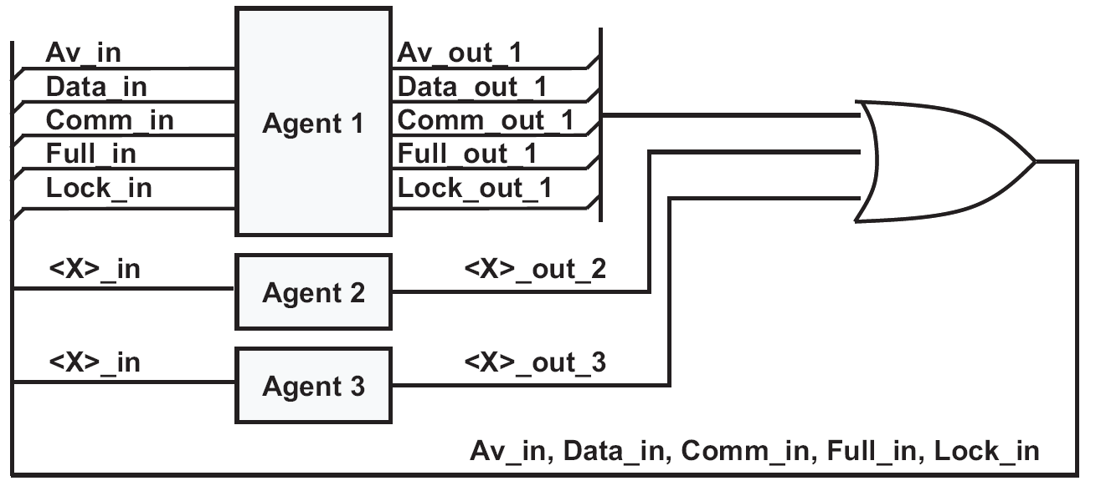
HIBI bus
Implemented as OR-gate network
OR-gate
network

Slide 23
Arbitration
Arbitration decides current bus owner
Totally distributed: all wrappers decides by themselves, when to access
No req/grant signalling or central arbiter
Bus is ”offered” to one wrapper on each cycle
Multiple policies
Fixed priority, Round-robin
Dynamically adaptive arbitration (DAA)
Time-division multiple access (TDMA)
Random, Combination of above

Slide 24
TDMA, Priority and Round-robin arbitration
Priority/round robin: If agent does not use, turn to next agent in next clock cycle
Fixed arbitration delay to each agent
time frame
time frame
A1
A3
A2
A3
A1
A3
t
competition
allocated time slot
competition
Priority
A1
A1
A2
A1
A3
A1
A2
A3
A1
t
A3
Round-robin
A3
A2
A1
A2
A3
A1
A2
A3
t

Slide 25
HIBI commands
Source IP sets the command
Most commands are forwarded to the receiving IP
Most common:
Write data - regular send operation
Read request
Split-transaction, the requested data is returned later with regular write command
Read request is always: 1 dst address + 1 address where to return the requested data

Slide 26
HIBI commands (2)
Less common
Idle – IPs never use this command, but this appears on the bus when no-one sends anything
Write message (=high priority data) – bypasses normal data in the wrappers, otherwise just like regular send operation
Write config, read config – access the configuration memories inside the wrappers. Not forwarded to the IP at the receiving end
Multicast data, multicast hi-prior data – send the same data to multiple targets

Slide 27
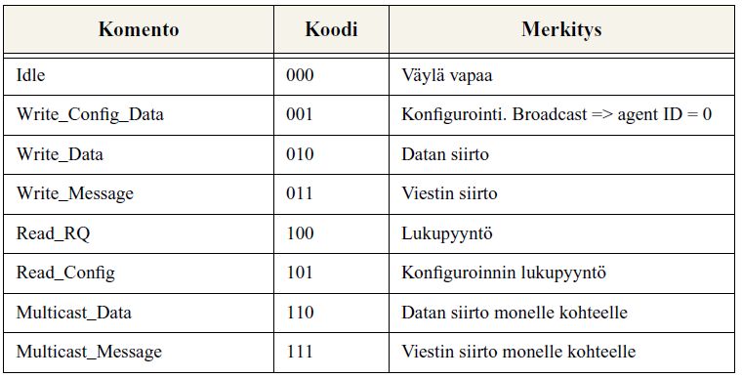
HIBI Bus Commands

Slide 28
HIBI Addressing
Every wrappers has a set of addresses
Set with a VHDL generic (automatic by Kactus)
Wrappers may have varying address space sizes
E.g. UART has only 2 addresses, memory has 16K addresses
Addresses go through the receiving wrapper to the receiving IP
IP can identify the incoming data by its address
Two ways to set addresses
manually
Kactus generator does this automatically

Slide 29
Addressing (2)
Based on bit masks
Wrappers compare only the uppermost bits of the incoming address
Number of mask bits is wrapper-specific
More mask bits, less addresses and vice versa
The size of the mask defines the lowermost ’1’-bit on wrapper’s own address
IP gets only the data that are preceeded by an address within range 0xF000-0XFFF.
Hence, this IP’s address space is 12 bits, 0xFFF = 4096 addresses
Example:
HIBI wrapper
bus side
IP side
data/addr
addr_g 0xF000
data/addr
Address bits are
0b1111 00...0.
Hence, the 4 uppermost bits are compared
data/addr
data/addr

Slide 30
Addressing example
IP address space
0x5000 – 0x5FFF
IP address space
0x3000 – 0x3FFF
IP BLOCK
IP BLOCK
addr_g 0x5000
HIBI
Wrapper
HIBI bridge
HIBI
Wrapper
addr_g 0x3000
HIBI
Wrapper
HIBI
Wrapper
addr_g 0x7000
HIBI
Wrapper
addr_g 0x2000 (inv)
HIBI
Wrapper
addr_g 0x5000
IP address space
0x7000 – 0x7FFF
IP BLOCK
0x4000 – 0xFFFF
IP BLOCK
IP address space
0x1000 – 0X1FFF
IP BLOCK
addr_g 0x2000
0x2000 – 0x3FFF

Slide 31
Addressing and bursts
IP may write arbitrarily long bursts to wrapper
Perhaps only one address in the beginning followed by arbitrary number of data words.
IP writes data in arbitrary pace to wrapper. There can be any number of idle cycles between data words.
Bursts that wrappper sends to bus do not necessarily have the same length as those from IP
Wrapper may send many short IP-transfers consecutively at one turn
Wrapper may split long IP-transfer into multiple bus transfers

Slide 32
Addressing and bursts (2)
Consequence1:
Bursts from multiple source IP will be interleaved
Consequence2:
Destination may get different number of addresses than sender
Due to multiplexed addr/data lines, it is beneficial to send many data into single address
In contrast to ”traditional” memory accesses, with address and data at the same time
The destination IP should keep track of received data count
E.g. TUT’s SDRAM controller can do this to avoid excess transmitting addr + data pairs
Destination does not know the sender unless it is separately encoded into data or address

Slide 33
HIBI Basic transfer
Burst transfers: 1 address + n data words
Max. n is wrapper-specific
No wait cycles allowed in the bus, but IP can write data in any pace it wishes
Transfer is pipelined with arbitration
Split-transactions: separate request and response
HIBI bus signals
Legend:
Colors denote different IP blocks
rd =read request
rq = request
ret =return
wr= write
av
cmd
data/addr
rd
rd
wr
wr
wr
wr
wr
...
rq addr
ret addr
w addr
w data
w data
ret addr
rq data
...
t
split transaction

Slide 34
IP side
IP BLOCK
IP BLOCK
HIBI
Wrapper
HIBI
Wrapper
HIBI
Wrapper
HIBI
Wrapper
HIBI
Wrapper
IP BLOCK
IP BLOCK
IP BLOCK

Slide 35
Signals at IP interface
Mostly the same signals at IP (=agent) and bus side
All output signals of the wrapper come from registers
Interface signals are connected to FIFO buffers inside the wrapper
3
cmd
IP (= agent)
HIBI wrapper
n
Data (/ addr)
Tx signals: IP sends data to network
n
(addr)
bus
address valid
write enable
Optional, see wrapper types
full
cmd
3
(addr)
n
Rx signals: IP receives data from network
Data (/addr)
n
address valid
read enable
empty

Slide 36
HIBI signals on IP side
Signal | Width [bits] | Dir. | Meaning
rst_n | 1 | i | Active low reset
clk | 1 | i | Clock, active on rising edge. Same for all wrappers inside one segment
data | gen. | i+o | Data and address are multiplexed into single set of wires
av | 1 | i+o | Address valid. Notifies when address is transmitted
cmd | 3 | i+o | Command: read or write, data or configuration etc.
re | 1 | i | Read enable. Removes the first data from RX FIFO
we | 1 | i | Write enable. Adds the data from IP to TX FIFO
full | 1 | o | Tx FIFO is full
empty | 1 | o | Rx FIFO is empty
one_p | 1 | o | Tx FIFO is almost full; only one place is left
one_d | 1 | o | Rx FIFO is almost empty; only one data is left
Direction is w.r.t. HIBi wrapper. I.e. input signals (i) come from IP, output signals (o) go to IP
36

Slide 37
Signals at IP interface
Driven by both IP and wrapper
Command
Address / Address valid
Data
May have high (message) and low (data) priotities (depends on wrapper type)
Driven by IP-block
FIFO access control signals
Write enable, Read enable
Driven by wrapper
Status signals
Always used: FIFO full and FIFO empty
Can be used: one data left at FIFO, one place left at FIFO

Slide 38
Signal Naming at HIBI Wrapper
All signals are unidirectional
The side and direction are marked into signal name in HIBI wrapper VHDL
agent_data_in, agent_data_out,
bus_data_in, bus_data_out
IP (=agent)
IP side
agent_data_in
agent_data_out
hibi_wrapper
bus_data_out
bus_data_in
bus side

Slide 39
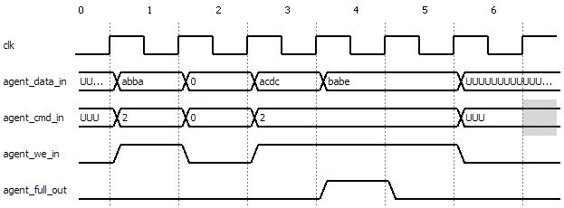
Basic signal timing when IP transmitting
IP checks that tx FIFO is not full
IP sets data, command, addr/av, and write_enable=1 for one clk cycle
Signal names refer to HIBI wrapper
Addr/AV not shown in figure
1st data written to TX FIFO
3rd data written to TX FIFO
2nd data written to TX FIFO, FIFO becomes full
FIFO is now full, nothing written

Slide 40
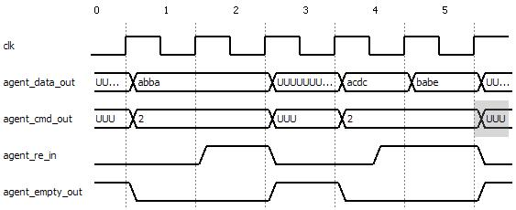
Basic signal timing when IP receiving
IP checks that rx FIFO is not empty
IP captures data, command, and addr/av
IP sets read_enable=1 for one clk cycle
Signal names refer to HIBI wrapper
Addr/AV not shown in figure
1st data arrives
2nd data arrives and IP sets re combinatorially
3rd data arrives and it is read immediately, FIFO is now empty again
1st data removed from rxFIFO, FIFO becomes empty

Slide 41
Notes on signal timing
Very easy to write/read on every other cycle
Almost as easy to write/read on every cycle
Needs more care with checking empty and full
See VHDL example
Signal FIFO full comes from register
It goes high on the next cycle after the write, if at all
For example, writing 0xacdc filled the FIFO
Setting we=1 when FIFO is full has no effect
Setting re=1 when FIFO is empty has no effect

Slide 42
Notes on signal timing (2)
Received data, addr/av and command appear to interface, if FIFO was empty before
IP can use them directly
They are removed only when read enable is activated
Checking empty==0 ensures validity
Data and command values are undefined when FIFO is empty
Most likely the old values remain
IP may keep we=1 and re=1 continuously
Change/store data according to full/empty

Slide 43
VHDL example
Simple example code can be found in SVN
/release_1/lib/hw_lib/ips/computation/image_xor/tb/tb_image_xor_linemaker.vhd
It shows how to
send address and data
However, address sending does not check FIFO full
read the received data
Figure shows the simple FSM of the example
not (two_lines_sent)
OK and all_read
OK and not (all read)
always
start
always
send_lines
two_lines_sent
verify_result
not (OK)
done
Write the destination address
Send test data to ”XOR”-IP block
Read the results
Do nothing

Slide 44
VHDL example (2)
Sometimes the output registers of the IP may cause unexpected behavior
Even if FIFO is not full, IP cannot necesarily write new data. That happens if it is already writing and there is only one place left at the FIFO
Remember to check if IP is already writing!
if (we_r =’1’ and one_p_in=’1’) or full_in =’0’ then
we_r <= ’0’; //FIFO becoming or already full
else
we_r <= ’1’; // There is room in FIFO
data_r <= new_value;

Slide 45
VHDL example (3)
HIBI wrapper shows the data as soon as it comes from the bus
Same data might get used (counted) twice, if IP only checks the empty signal
Remember to check if IP is already reading!
if (re_r = '1' and one_d_in = '1') or empty_in = '1' then
re_r <= '0'; // Stop reading
else
re_r <= '1'; // Start or continue reading
end if;
if re_r = '1' then
if hibi_av_in = '0' then
// handle the incoming address
else
// handle the incoming data

Slide 46
Common pitfalls
Not noticing that tx FIFO fills while writing
Consequence: Some data are lost (not written to FIFO)
Write enable remains 1 for one cycle too long
Undefined data written to FIFO, or the same data is written twice
In both of above, the likely cause is not acocunting to output register of the IP

Slide 47
Common pitfalls (2)
Not noticing that rx FIFO goes empty while reading
Data consumed by IP is undefined
Read enable remains 1 for one cycle too long
Next data is accidentally read away from the FIFO unless FIFO was empty
Not noticing that rx data changes only after the clock edge when re=1
IP uses the same data twice

Slide 48
HIBI Wrapper IP interface variants (2)
IP-block
IP-block
data
cmd
empty
re
data
cmd
empty
re
hi
lo
hi
lo
av
one_d
hi
lo
hi
lo
one_d
addr
hibi_wrapper_r1
All wrapper types contain r1 inside them
hibi_wrapper_r3
HIBI BUS
IP-block
IP-block
lo
lo
lo
lo
data
cmd
empty
re
data
cmd
empty
re
hibi_wrapper_r2
addr
one_d
one_d
hibi_wrapper_r4
av
r4 is the most used in TUT
HIBI BUS

Slide 49
HIBI Wrapper IP interface variants
There are 4 variants of the IP interface
Depending on how to handle
high/low priority data: one or two interfaces
address and data: separate interfaces or one multiplexed
r1: a) 2 interfaces hi+lo; b) muxed a/d
r2: a) 1 interface hi/lo; b) separate a+d
r3: a) 2 interfaces hi+lo; b) separate a+d
r4: a) 1 interface hi/lo; b) muxed a/d

Slide 50
IP interface variants (3)
Different wrapper types can co-exist in the same system
Bus side interface is always the same
Addresses work directly between wrapper types
Hi-priority data cannot bypass lo-prior data in wrapper types r2 and r4. However, all data is always transmitted
For example, Nios subsystems utilize commonly r4 but SDRAM utilizes r3
SDRAM ctrl distinguishes DMA configuration and memory data traffic with priority

Slide 51
Configuration of HIBI

Slide 52
HIBI wrapper configuration
Design time: structural and functional settings
Run-time: data transfer properties (arbitration types, wrapper specific QoS settings)
Wrapper has config memory that stores all information for distributed arbitration
Permanent: ROM, 1 page
Semi run-time configurable: ROM with several pages
Full run-time configurable: RAM, with pages
Kactus supports currently 1-page ROM
Curr page
New
conf
values
Curr
conf
values
Conf page
Mux
Demux
Cycle counter
Time slot
logic
Time
slot
signals

Slide 53
Generic and VHDL default | Category | Type | Value range | Description | Entry in Kactus
addr_width_g : integer := 32; | Bus widths | Bits | less than or equal data_width_g | address bus width if separate | N/A currently
data_width_g : integer := 32; | Bus widths | Bits | positive integer | width of multiplexed address and data bus | N/A currently
comm_width_g : integer := 3; | Bus widths | Bits | practically always 3 | width of command bus | N/A currently
counter_width_g : integer := 8; | Bus widths | Bits | greater or equal than (log(max_send) | width if the internal counters in a wrapper | N/A currently
debug_width_g : integer := 0 | Bus widths | Bits | positive integer | width of debug port (for special monitors) | N/A currently
 |  |  |  |  | N/A currently
rx_fifo_depth_g : integer := 5; | FIFO | Words | 0,2,3… | Rx fifo depth | Must be set manually
rx_msg_fifo_depth_g : integer := 5; | FIFO | Words | 0,2,3… | Rx message (high-priority) fifo depth, not available in all wrapper types | Must be set manually
tx_fifo_depth_g : integer := 5; | FIFO | Words | 0,2,3… | Tx fifo depth | Must be set manually
tx_msg_fifo_depth_g : integer := 5; | FIFO | Words | 0,2,3… | Tx message (high-priority) fifo depth, not available in all wrapper types | Must be set manually
fifo_sel_g : integer := 0; | Clock domains | Number | 0-3: Synchronous multi-clock GALS (globally asynchronous, locally synchronous) Gray FIFO Mixed clock pausible | Type of the synchronizing FIFO buffers between bus and agent | N/A currently
rel_agent_freq_g : integer := 1; | Clock domains | Number | positive integer | Relative frequencies of IP and bus, Needed at least for synchr. multiclk FIFOs | N/A currently
rel_bus_freq_g : integer := 1; | Clock domains | Number | positive integer | see above | N/A currently
addr_g : integer := 46; | Addressing | Number | positive integer | unique address for each wrapper | Automatically set by generators, override VHDL defaults
inv_addr_en_g : integer := 0; | Addressing | Number | 0 or 1 | only for bridges, other half uses 0 and the other 1 | N/A currently
multicast_en_g : integer := 0 | Addressing | Number | 0 or 1 | enable special addressing | N/A currently
n_agents_g : integer := 4; | Arbitration | Number | positive integer | total number of agents within one segment (distributed arbitration requires this) | Must be set manually
prior_g : integer := 2; | Arbitration | Number | less than or equal n_agents | unique priority value for all wrappers within one segment | Must be set manually
max_send_g : integer := 50; | Arbitration | Number | in words, 0 means unlimited | max words the wrapper can reserve bus | N/A currently
n_time_slots_g : integer := 0; | Arbitration | Number |  | Number of time slots in a TDMA frame. TDMA is enabled by setting n_time_slots > 0. Ensure that all wrappers in a segment agree on arb_type, n_agents, and n_slots. Max_send can be wrapper-specific. | N/A currently
arb_type_g : integer := 0; | Arbitration | Number | 0 round-robin, 1 priority, 2 combined, 3 DAA | Arbitration type | N/A currently
keep_slot_g := 1 | Arbitration | Number | For TDMA: 0 release unused time slots 1 keep unused slots | Keep reserved but unused slots in TDMA. Not used in HIBI revision r3 | N/A currently
id_g : integer := 5; | Reconfiguration | Number | positive integer | unique wrapper identification for reconfiguration (address is normally used) | Set manually (user must set)
id_width_g : integer := 4; | Reconfiguration | Number | greater than or equal(log2(id_g)) | wrapper identification size = max number of wrappers | N/A currently
base_id_g : integer := 5; | Reconfiguration | Number | positive integer | only for bridges, which cfg id are routed acrossa the bridge | N/A currently
cfg_re_g : integer := 0; | Reconfiguration | Number | 0 or 1 | enable reading configuration memory | N/A currently
cfg_we_g : integer := 0; | Reconfiguration | Number | 0 or 1 | enable writing configuration memory | N/A currently
n_extra_params_g : integer := 0; | Reconfiguration | Number | positive integer | Number of app-specific extra registers | N/A currently
n_cfg_pages_g : integer := 1; | Reconfiguration | Number | 1,2,3... | Number of configuration pages. Having multiple pages allows fast reconfig. Note that cfg memory initialization is done with separate package if you have many time slots or configuration pages | N/A currently

Slide 54
Generic values of a wrapper
Stuctural
Widths of interface ports: data, command, debug port
Widths of internal signals: address, wrapper identifier field, counters
Sizes of tx and rx FIFOs, both lo and hi priorities
Use 0, 2, 3 etc.
Run-time configuration: number of cfg pages, num of app-specific extra registers
Synchronization
Type of the synchronizing FIFO buffers
Relative frequencies of IP and bus

Slide 55
Generic values of a wrapper (2)
Functional
Identifier, own address
For bridges: base identifier, inverted address space ’
Arbitration: type, priority, how many words to at one turn, number of agents in the same segment
For TDMA: number of time slots, how to handle unused slots (keep/give away)
Enable/disable multicast functionality
Enable/disable runtime configuration functionality (affects structure=area as well)

Slide 56
Special clocking
HIBI can support may clock domains:
Border between IP and wrapper
Border in the middle of a bridge
Options:
Synchronous multi-clk:
Clock frequencies are integer-multiples of each other
Clocks are in the same phase
Easy to use with FPGA’s PLLs
GALS
No assumptions about relations (phase, speed) between clocks
Has longer synch. latency than synch.multiclock
Gray
FIFO depth limited to power of two (=2^n)
Mixed clock pausible

Slide 57
Using HIBI in Kactus design

Slide 58
Instantiating HIBI in Kactus
Two options:
Easy to use HIBI segment component
IP component does not contain HIBI wrapper, only IP-side wrapper signals
Benefit: fast, all wrappers updated at the same time
Assembling with wrappers
IP-blocks, wrappers and segments individually configurable

Slide 59
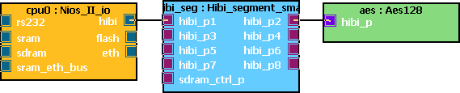
1) HIBI segment component in Kactus
Contains set of wrappers and network
Faster at design entry but limited configuration
Synthesis tool (e.g. Quartus) removes unused wrappers from final design
HIBI OR -NETWORK
IP
HIBI
WRAPPER
HIBI
WRAPPER
IP

Slide 60
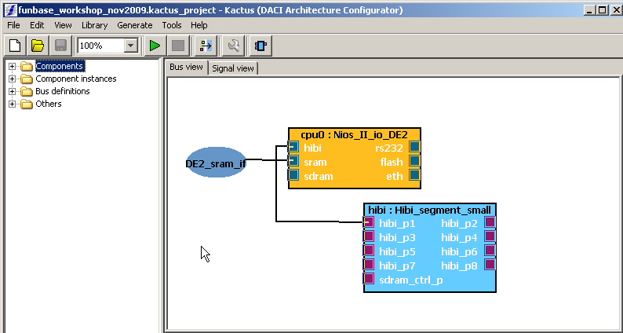
HIBI segment component
IP block priority in bus is based on port number
p1 is highest, p8 least in example
Connect components in order from highest port to avoid empty arbitration clock cycles
Future: more flexible configuration in Kactus

Slide 61
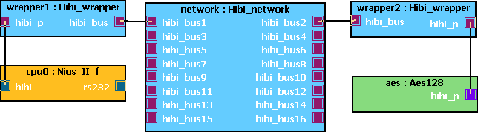
2) Individual HIBI wrappers in Kactus
Wrappers are individually configured for IP needs
Designer must take care of priorities and unique IDs for IP-blocks
Synthesis tool (e.g. Quartus) removes unused wrappers from final design
HIBI OR -NETWORK
IP
HIBI
WRAPPER
HIBI
WRAPPER
IP

Slide 62
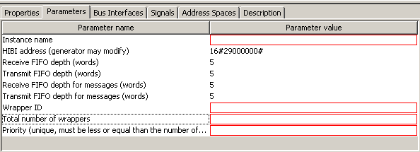
2) Individual HIBI wrappers in Kactus
Settings per wrapper in Kactus
Type here unique name for this wrapper
This is overriden by Kactus generators
This is default defined in IP-XACT component
Type here unique ID number
Type here how many wrappers are present in one segment
Type here priority to this wrapper, do not use same for more than one
Note: in future, these settings will be automatically filled in from system model (UML) or from Kactus generators (e.g. number of agents)
Generics at VHDL source code are overridden by default values defined in IP-XACT component

Slide 63
HIBI IP-XACT Design Example

Slide 64
IP-XACT Design Principle
Master
Component X
Instance 1
Component Z (IP block)
Instance 1
Mirrored Master
Bus interface M
Bus interface M
Bus interface S
Interconnection
Interconnection
Bus interface MM
Bus interface MM
Bus interface MS
Bus interface MS
Component B (bus component)
instance
Bus interface MS
Interconnection
Point-to-point Interconnection
Bus interface S
Mirrored Slave
Bus interface S
Component Y Instance 1
Slave
Component Y Instance 2
Main elements of IP-XACT designs:
Component instances referencing IP-XACT component documents
Point to point interconnections between bus interfaces of component instances
Note: “bus” is a logical component and not necessarily a bus in real interconection (e.g. ring, mesh, etc.)

Slide 65
IP-XACT component principle
Main elements of components are:
Bus interfaces, referencing bus definitions to describe the bus type
Memory maps, including register descriptions
Physical signal descriptions
Views, referencing non-IP-XACT data or lower level designs.
Bus interface B1
Bus type X
Slave
Memory map map1
Bus interface B2
Bus type Y
Master
Register R0
Register R1
Component
Signal map
Signal Map
Signals
Physical signal Sig1
Physical signal Sig2
Physical signal Sig3
View A
View B
View C
Reference to associated data (e.g. RTL model)
Reference to associated data (e.g. drivers)
Reference to Lower Level Design (IP-XACT Design Document)

Slide 66
HIBI IP-XACT Design Example
”Image XOR”
IP-block
Part of SoC:
One IP-block connected to a network
IP-XACT design
Image XOR (IP block)
Instance 1
Bus interface M
HIBI signals to/from IP
No bus component (but bus definition exists)
HIBI wrapper
Bus interface MM
HIBI Wrapper
Instance 1
Bus interface M
HIBI signals to/from network
Bus interface MM
HIBI network
Bus component instance 1
(HIBI network)
HIBI wrapper
HIBI wrapper

Slide 67
Example: IP-XACT metadata of HIBI SoC
IP-XACT
bus interfaces:
Hardware:
Defined in file:
”Image XOR”
IP-block
Bus interface master
Name: hibi_p
Bus Type: hibi_if
spirit_comp_def_image_xor.xml
Bus interface M
HIBI signals to/from IP
HIBI wrapper
Bus interface mirrored master
Name: hibi_p
Bus Type: hibi_if
spirit_bus_def_hibi_if_w4.xml
Bus interface MM
spirit_comp_def_hibi_wrapper_r4.xml
Bus interface master
Name: hibi_bus
Bus Type: hibi_bus_if
Bus interface M
HIBI signals to/from network
spirit_bus_def_hibi_bus_if.xml
HIBI network
Bus interface mirrored master
Name: hibi_bus1
Bus Type: hibi_bus_if
Bus interface MM
spirit_comp_def_hibi_network.xml
HIBI wrapper
HIBI wrapper

Slide 68
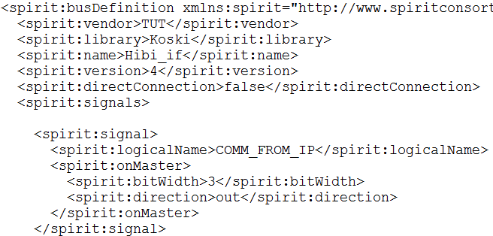
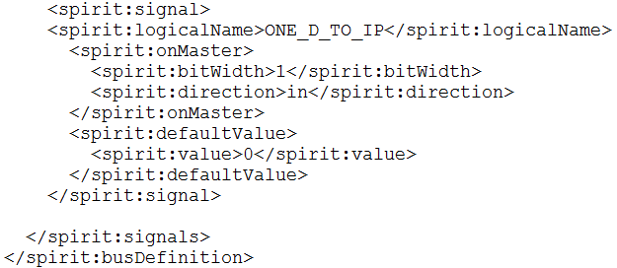
Bus definition: HIBI IP interface

Slide 69
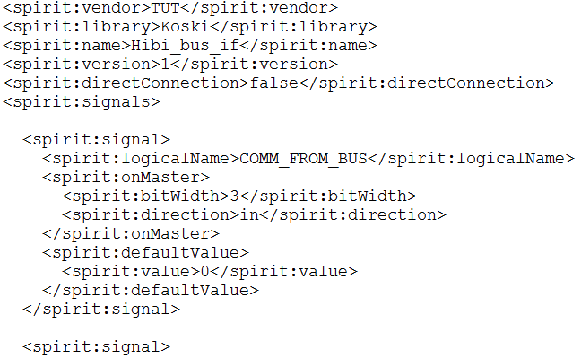
Bus definition: HIBI Bus interface

Slide 70
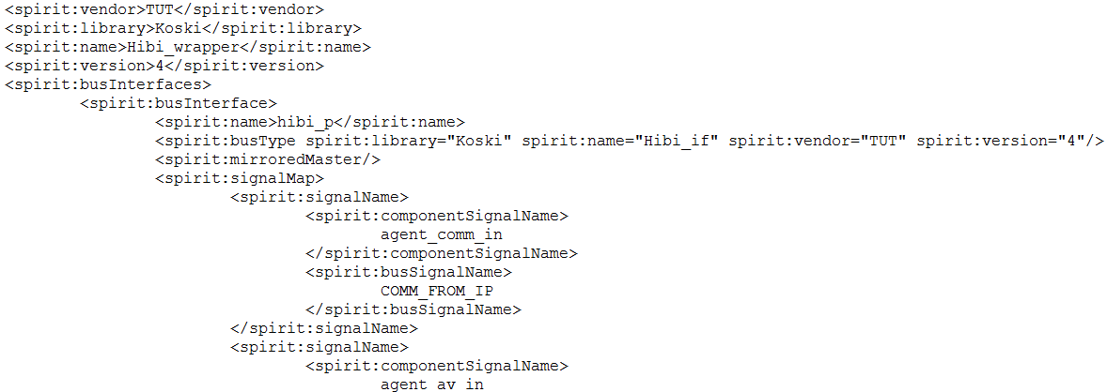
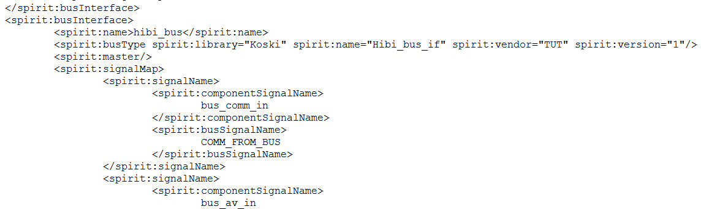
Component definition: HIBI wrapper type r4 (1)

Slide 71
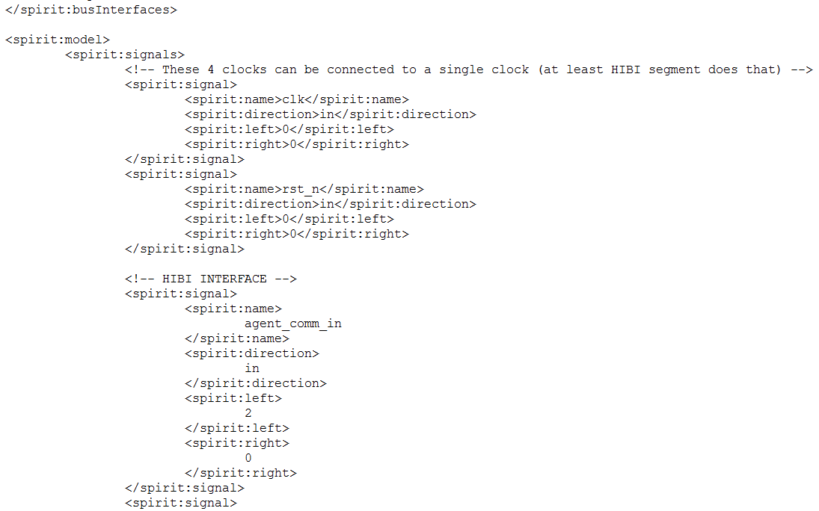
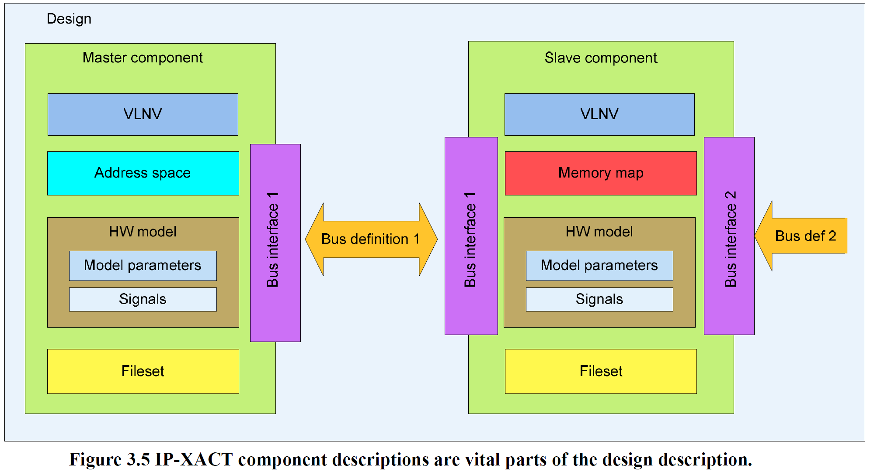
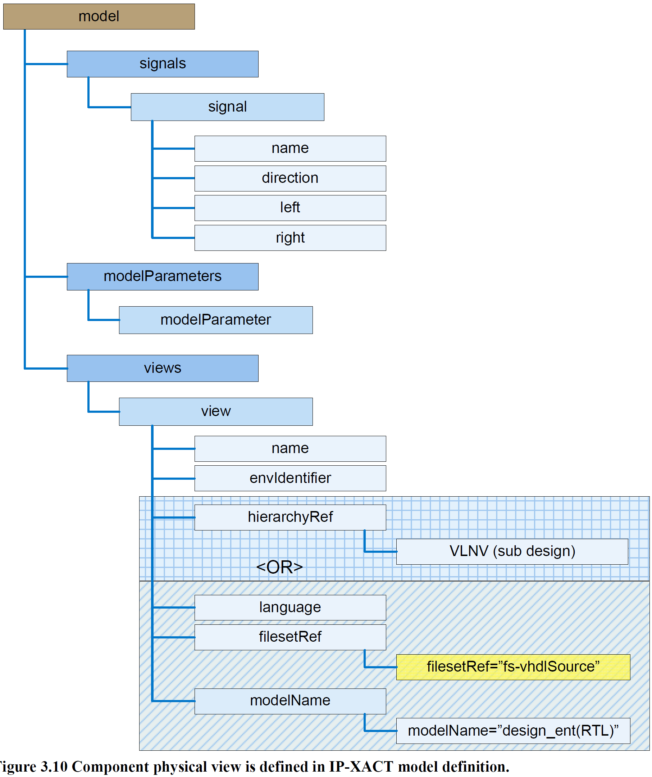
Component definition: HIBI wrapper type r4 (2)

Slide 72
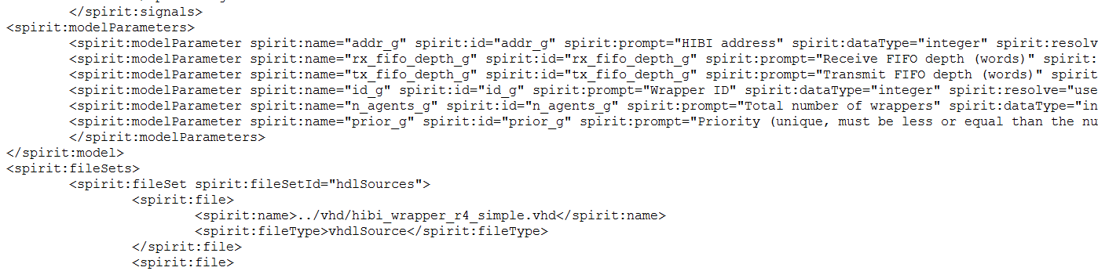
Component definition: HIBI wrapper type r4 (3)

Slide 73
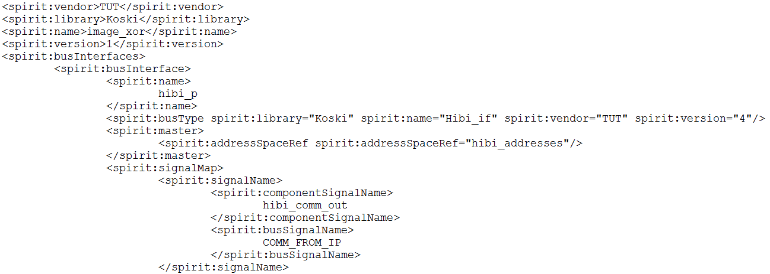
Component definition: Image XOR

Slide 74
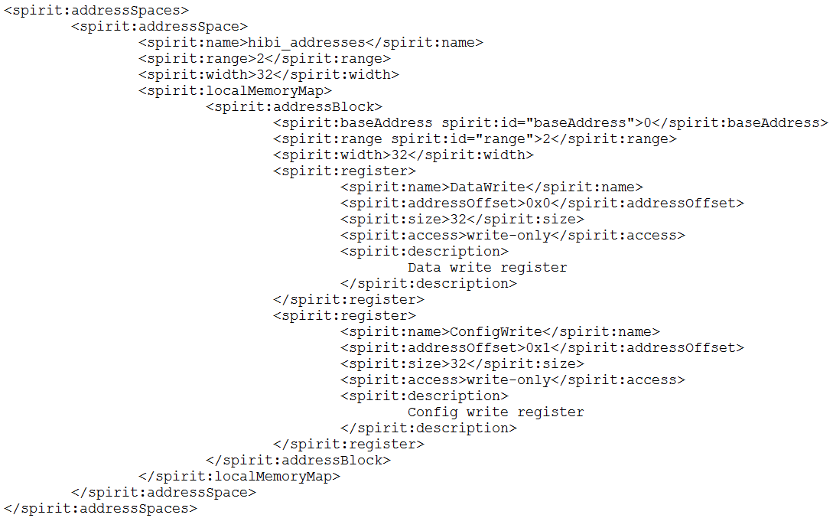
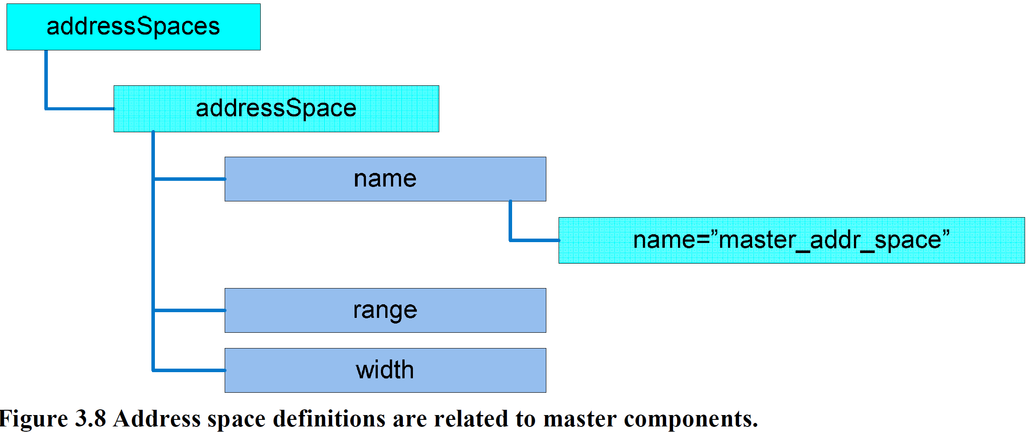
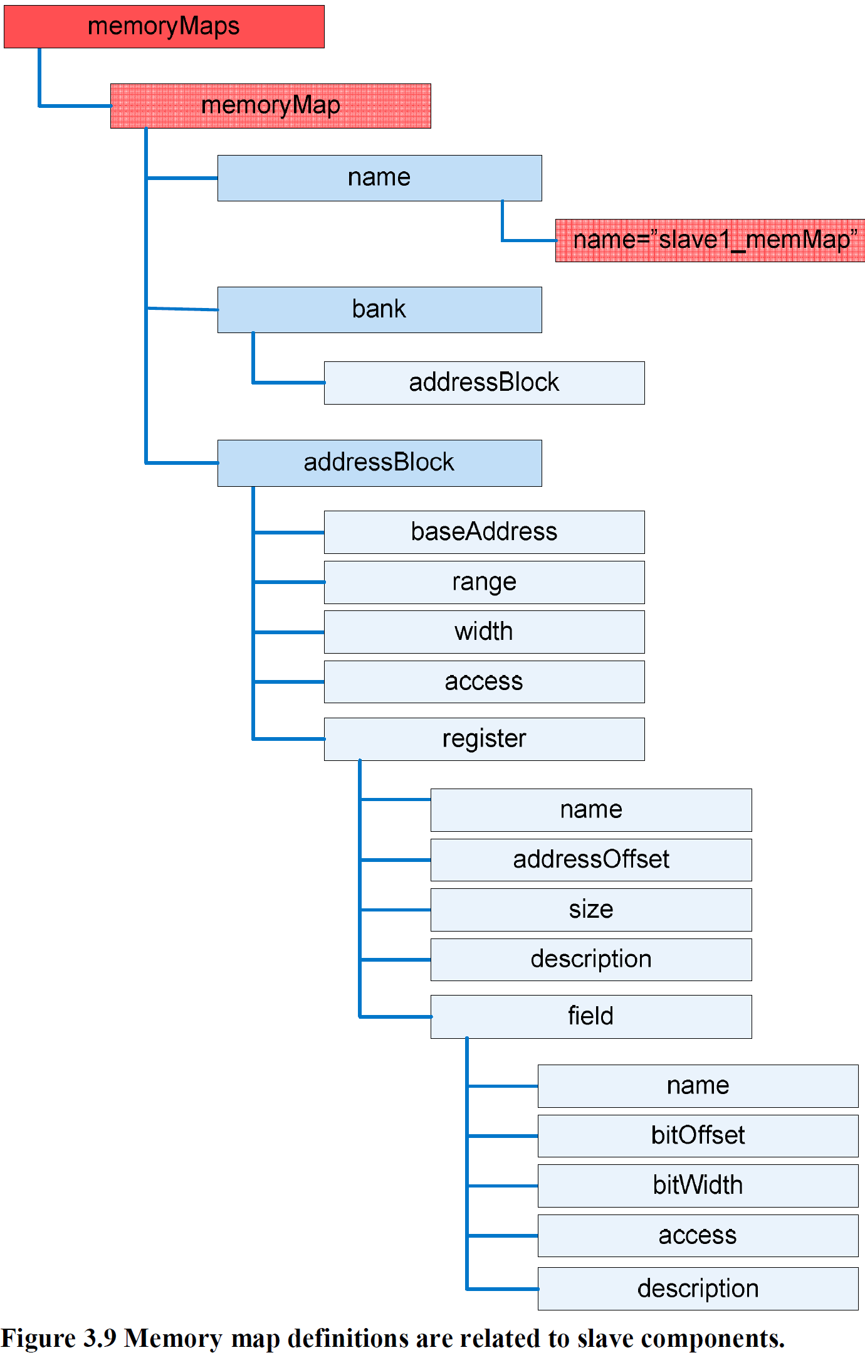
Component definition: Image XOR

Slide 75
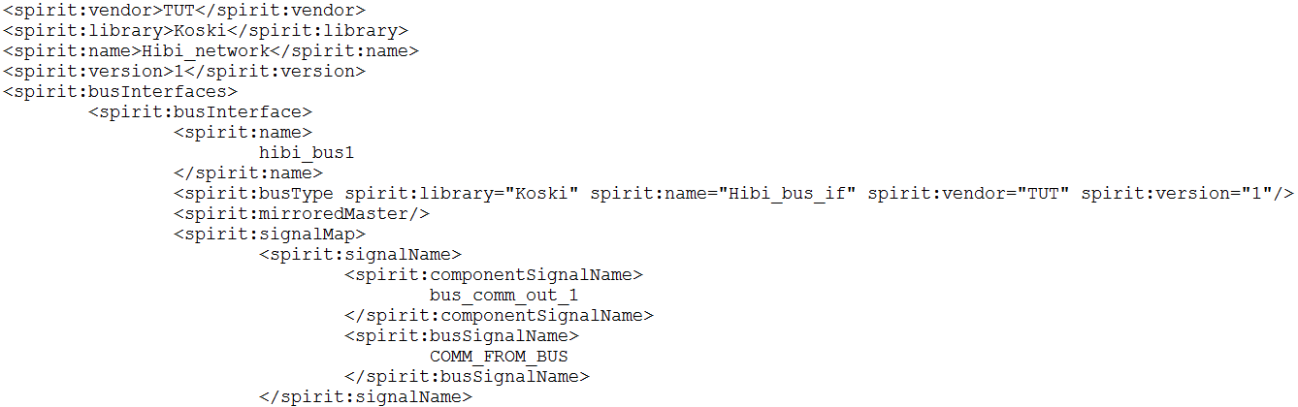
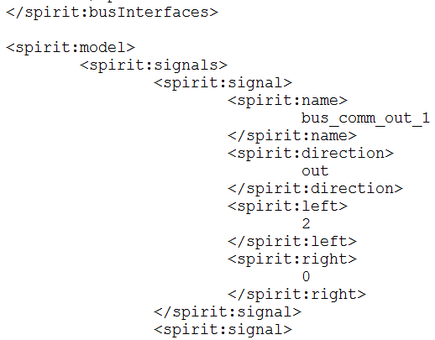
Component: Network

Slide 76
HIBI v3
Pictures for documentation

Slide 77
General layout
HIBI segment
Hibi wrapper R3
Hibi wrapper R3
HIBI phy
PCIe to HIBI
Cmp 0

Slide 78
General layout
HIBI wrapper R3
normal interface
HIBI wrapper R1
addr_data_mux_write
addr_data_mux_read
HIBI segment
HIBI component
addr_data_mux_write
addr_data_mux_read
message interface

Slide 79
HIBI wrapper resource usage – Arria II GX
comb. aluts: 533
registers: 935
comb. aluts: 533
registers: 935
HIBI wrapper fifo:
width: 38 bits (data 32, address_valid 1, comm 5)
size: 4 words
comb. aluts: 76-104
registers: 155-167
4 fifos in 1 R1 wrapper
HIBI wrapper R3:
comb. aluts: 724-763
registers: 1039-1168
HIBI wrapper R1:
comb. aluts: 466-533
registers: 825-935
HIBI wrapper R3
normal interface
HIBI wrapper R1
addr_data_mux_write
addr_data_mux_read
HIBI segment
HIBI component
addr_data_mux_write
addr_data_mux_read
message interface
comb. aluts: 533
registers: 935
comb. aluts: 533
registers: 935

Slide 80
HIBI wrapper R1
double fifo demux read
transmitter
HIBI segment
HIBI component
double fifo demux write
receiver

Slide 81
HIBI wrapper R3
double fifo demux read
normal interface
fifo mux read
fifo
HIBI wrapper R1
addr data mux write
HIBI wrapper R1
fifo
addr data mux read
transmitter
double fifo demux read
HIBI segment
HIBI component
addr data mux write
receiver
double fifo demux write
double fifo demux write
addr data mux read
fifo
message interface
fifo

Slide 82
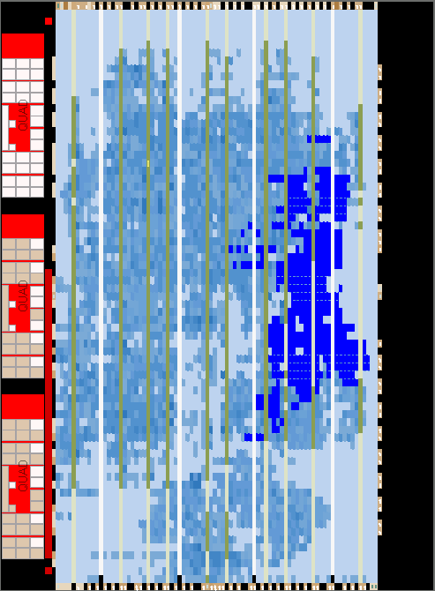
HIBI v3 resource usage
Onchip memories can also be used for the HIBI wrapper fifos
Requires atleast 12 m9k blocks per wrapper on a Arria II GX (one m9k memory 18 bits wide in two port mode, 32-bit HIBI wrapper fifo 38 bits wide)

Slide 83
HIBI v3 performance
troughput of a 32-bit HIBI segment, data and address on the same bus, transfer between two HIBI components without other signal traffic, 1024 word transfer:
Theoretical max performance would be achieved in 1025 cycles (1024 data cycles + 1 address cycle)
Wrapper fifo size 4 words: 1847 cycles
Wrapper fifo size 5 words: 1600 cycles
Wrapper fifo size 6 words: 1185 cycles
Wrapper fifo size 7 words: 1168 cycles
Wrapper fifo size 8 words: 1181 cycles
Wrapper fifo size 9 words: 1180 cycles
Wrapper fifo size 10 words: 1167 cycles
Wrapper fifo size 11 words: 1175 cycles
Wrapper fifo size 64 words: 1114 cycles
Wrapper fifo size 256 words: 1077 cycles

Slide 84
HIBI v3 performance

